Slide 1
Detect Pneumonia using Chest X-Ray Images
Jonathan Zhao

Slide 2
Background
According to World Health Organization(WHO), 2 million children under 5 years old killed by Pneumonia each year, and WHO reported that 95% of childhood clinical pneumonia cases occurred in developing countries (Kermany, 2018).
X-Ray images are able to obtained as standard care procedure. However, specialist for interpreting the images are not always available.
Utilize Convolutional Neural Network(CNN) to help detect Pneumonia using chect X-Ray images as preliminary screening.
Kermany, Daniel; Zhang, Kang; Goldbaum, Michael (2018), “Labeled Optical Coherence Tomography (OCT) and Chest X-Ray Images for Classification”, Mendeley Data, v2 http://dx.doi.org/10.17632/rscbjbr9sj.2

Slide 3
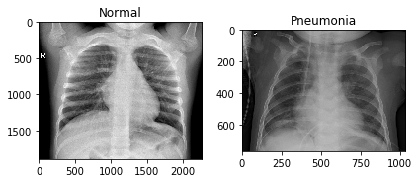
Data
Original dataset can be obtained from Mendaeley Data website.
The dataset includes Normal chest X-Ray images and Pneumonia chest X-Ray images, and split into train and test dataset.
All images are in JEPG format, but each image have different resolution.

Slide 4
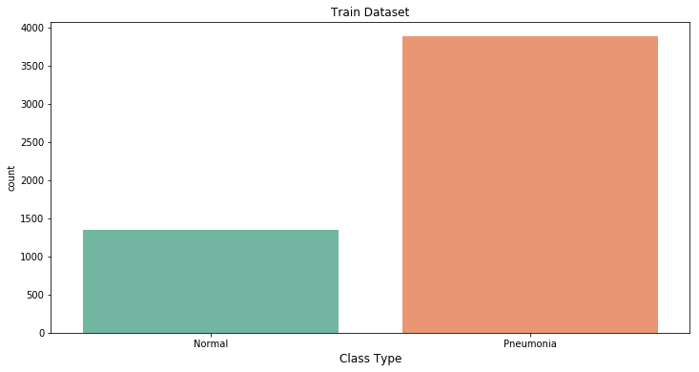
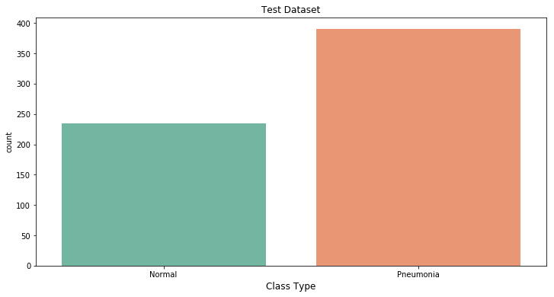
Data – cont.
Normal: 1349 (25.78%)
Pneumonia: 3883 (74.22%)
Normal: 234 (37.50%)
Pneumonia: 390 (62.50%)

Slide 5
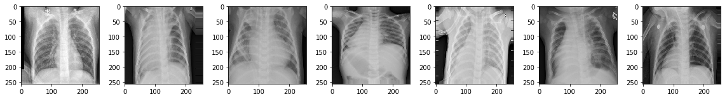
Data Augmentation and pre-processing
Produce more images via flip, rotate, shift, zoom, and etc.
Resize images
Shuffle dataset

Slide 6
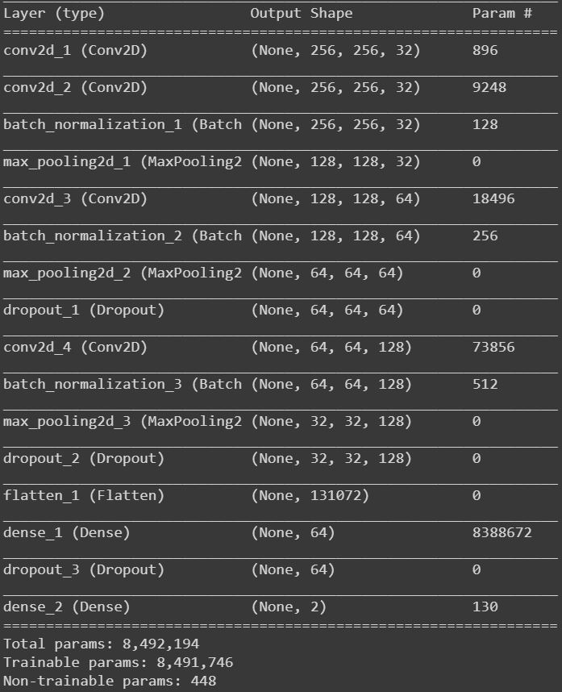
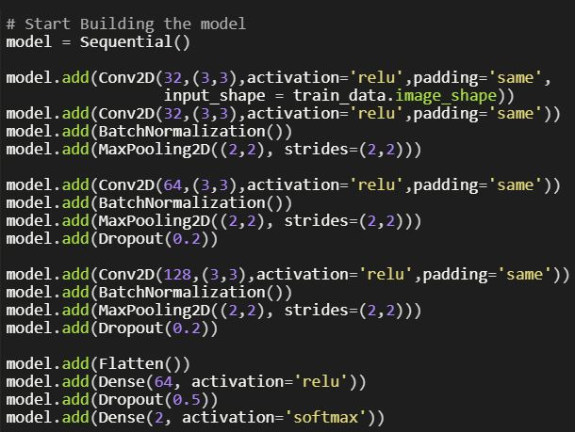
Cnn model

Slide 7
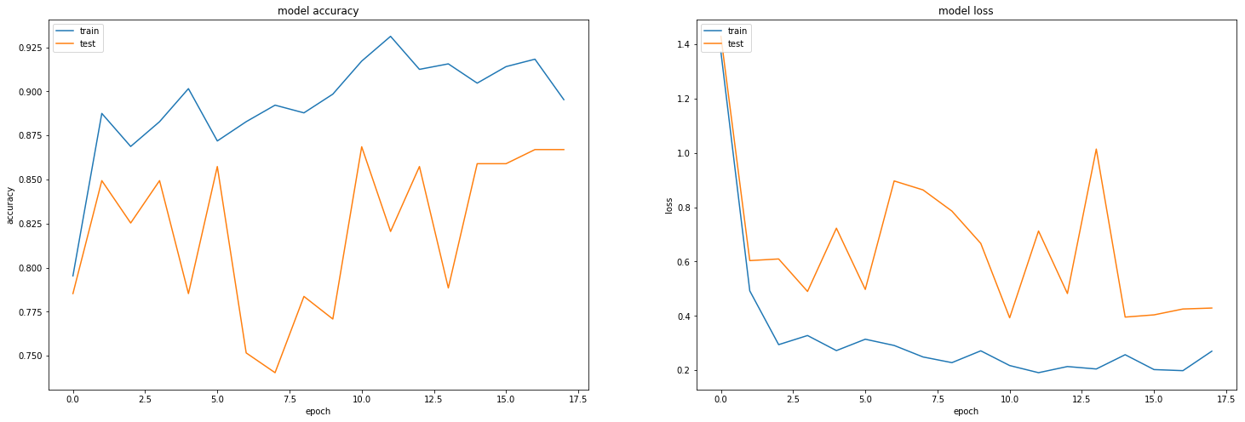
Model evaluation
Train Accuracy: 0.9172
Validation Accuracy: 0.8686
Train Loss: 0.2172
Validation Loss: 0.3930

Slide 8
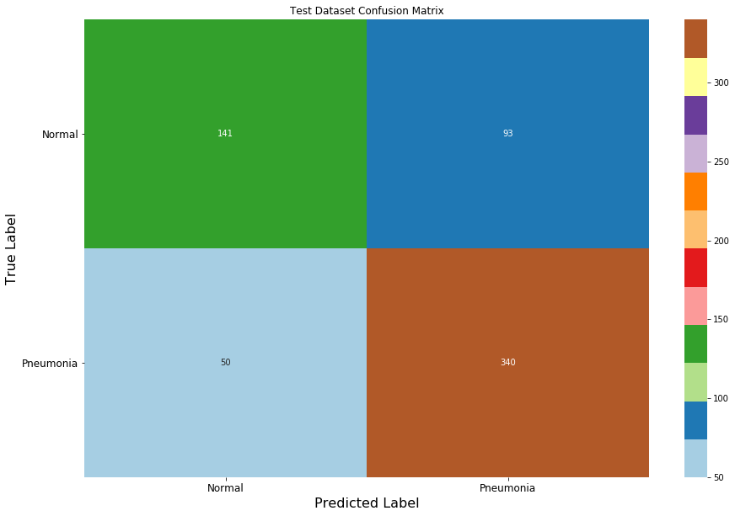
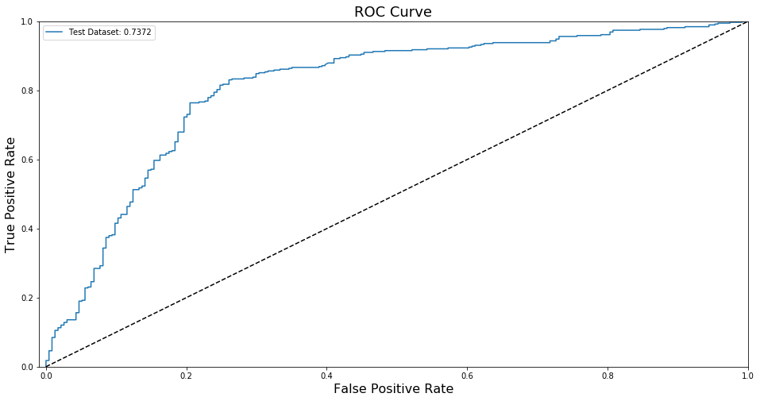
Model evaluation
Precision Score – 0.7852
Recall Score – 0.8718

Slide 9
Future improvement
Obtain reproducible results
Show prediction accuracy on image.
Class activation map
Transfer learning
https://keras.io/getting-started/faq/#how-can-i-obtain-reproducible-results-using-keras-during-development

Slide 10
THANK YOU!

